Slide 1

GitHub
Presented by:
Shaghayegh Rahmnai (Melanee)
Sep 2021

Slide 2
What is GitHub?
www.github.com

Slide 3
What is GitHub?
● Largest web-based git repository hosting service.
● Allows for code collaboration with anyone online.
● Adds extra functionality on top of git.

Slide 4
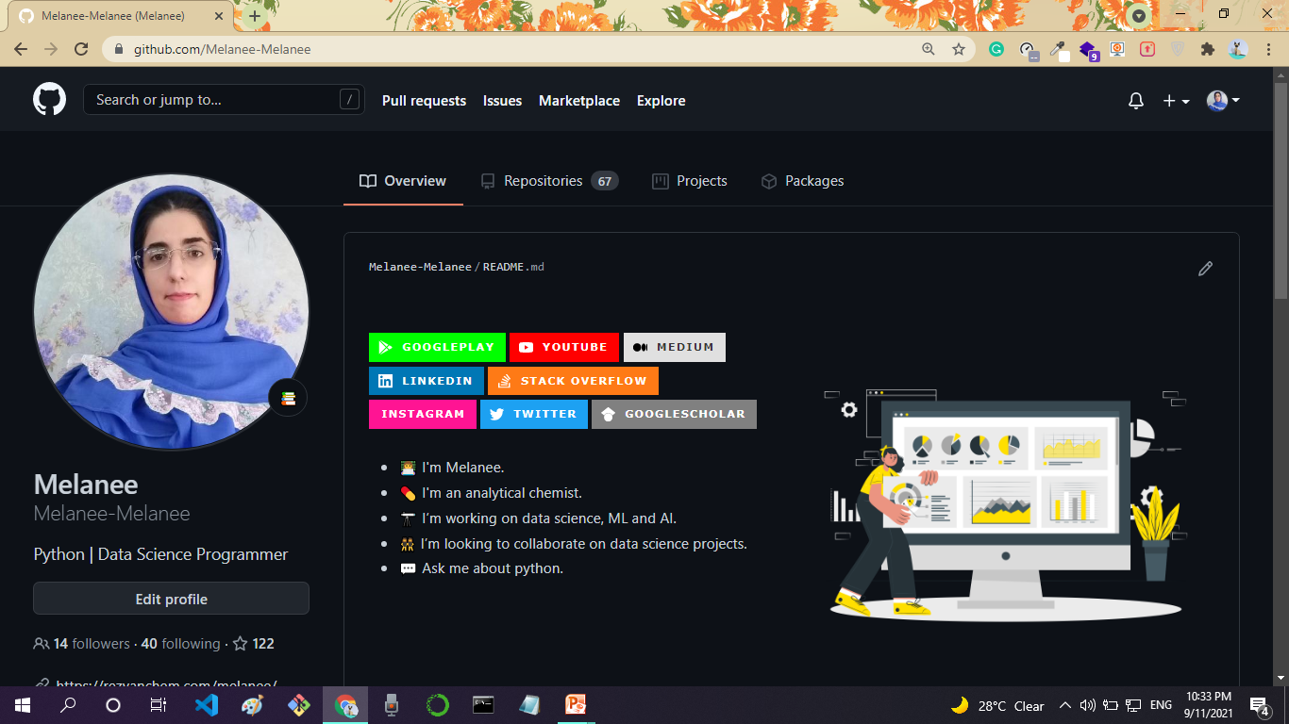

Slide 5
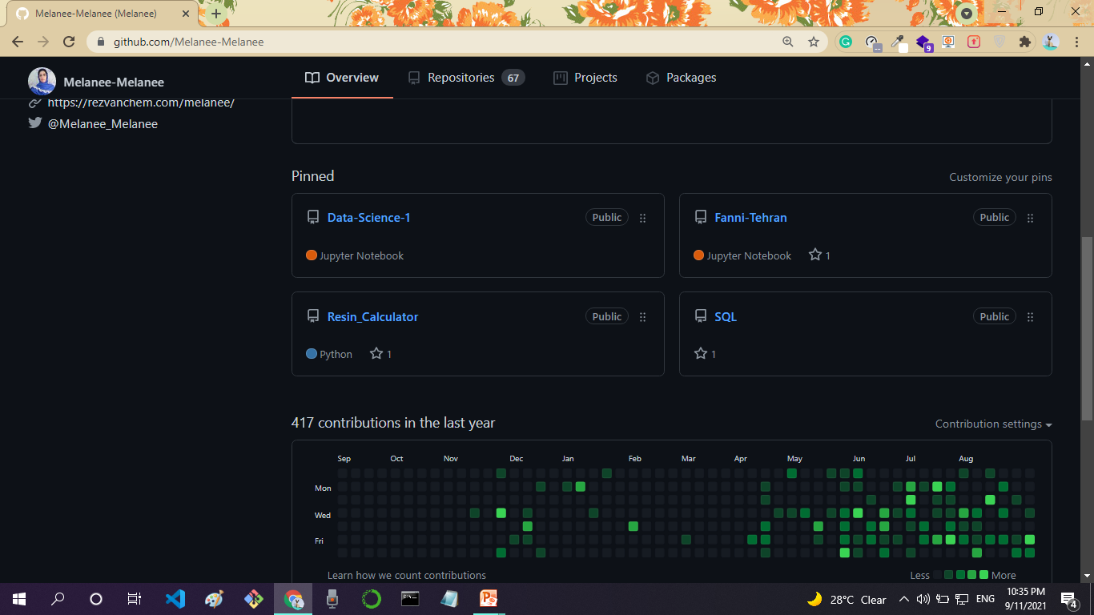

Slide 6
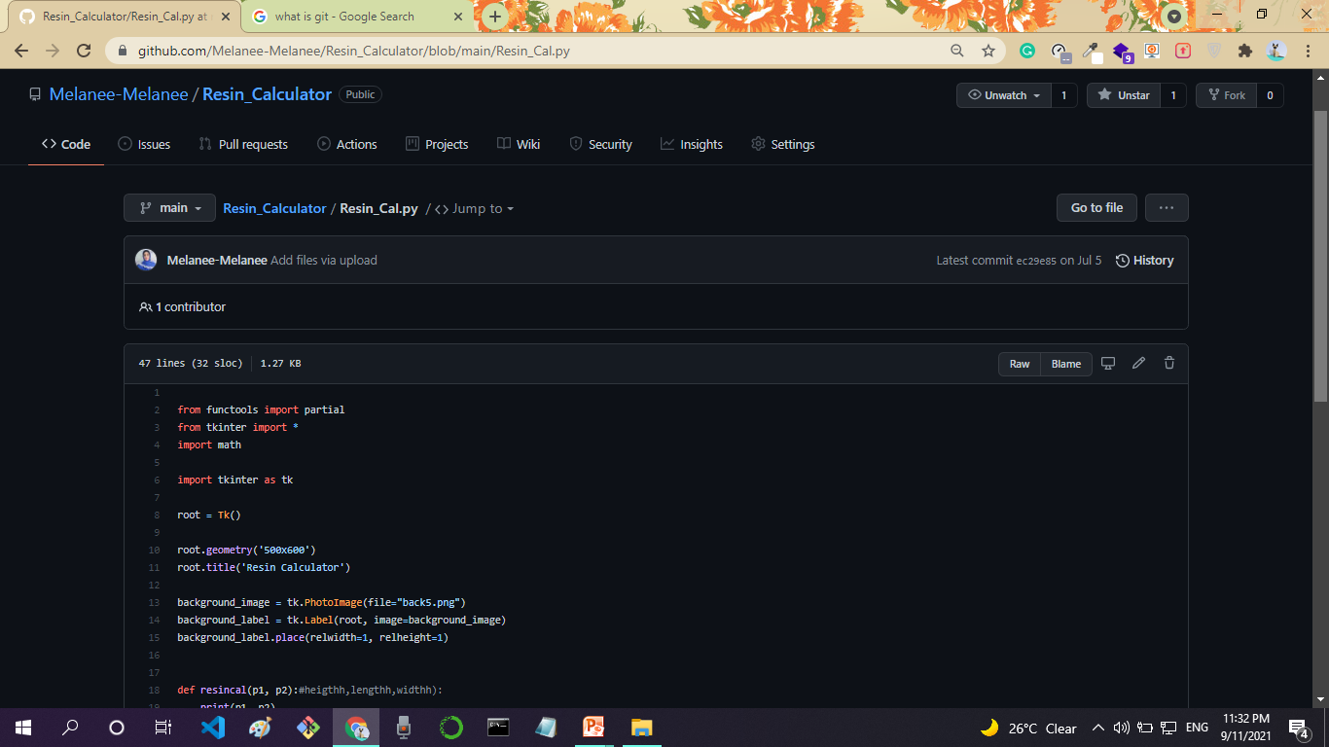

Slide 7
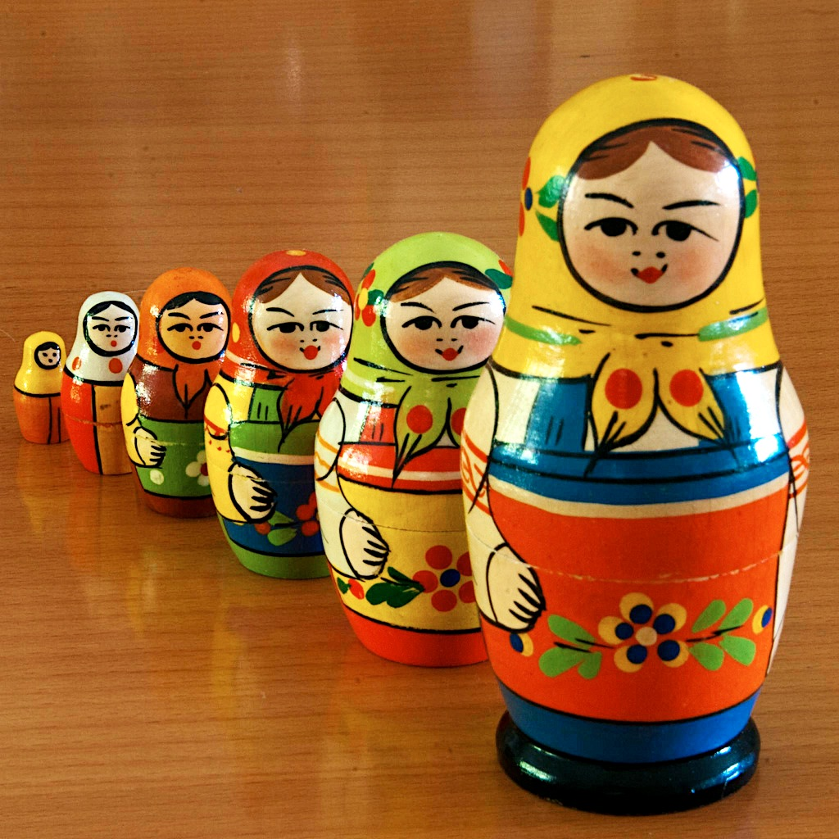
Version Control with Git

Slide 8


For implementing Version Control Systems (VCSs)

Slide 9
What is version controls?
● A system that keeps records of your changes.
● Allows for collaborative development.
● Allows you to know who made what changes and when.
● Allows you to revert any changes and go back to a
previous state.

Slide 10
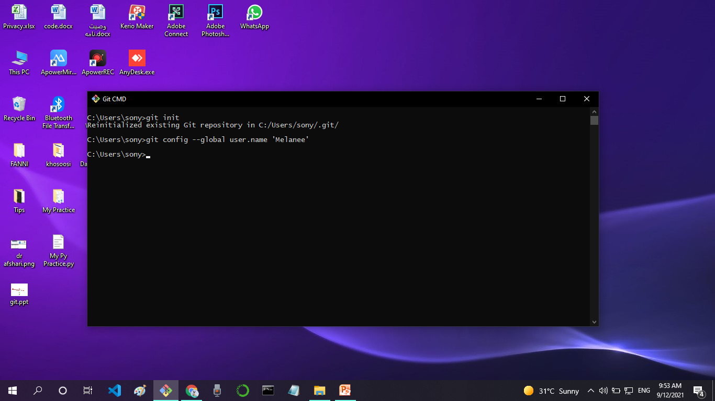

Slide 11
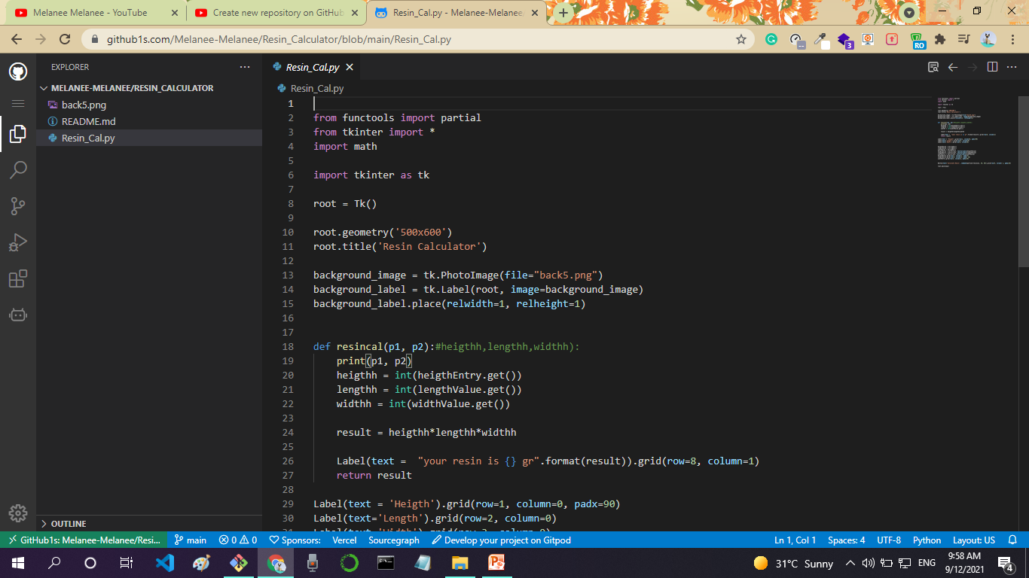

Slide 12
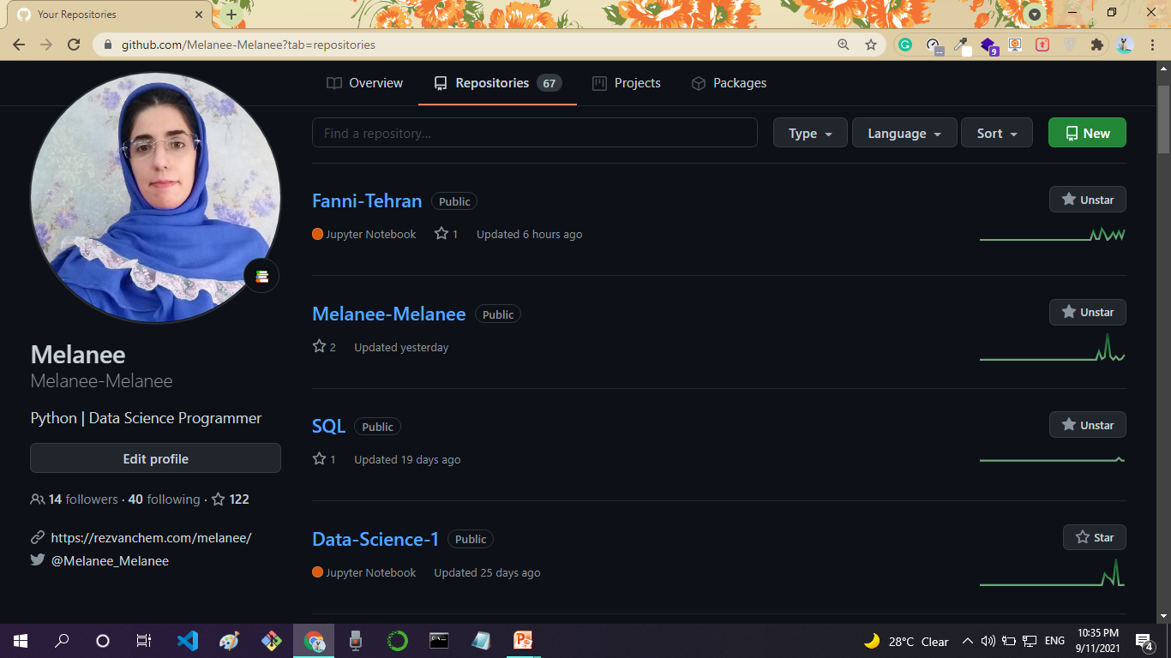

Slide 13
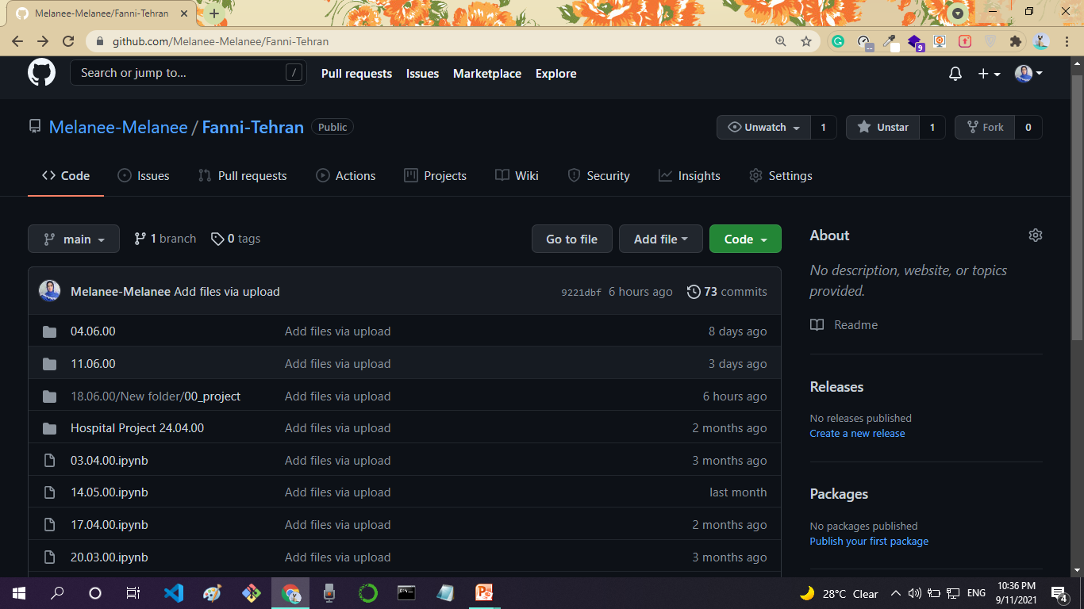

Slide 14
